Slide 1
C29PE Economics for Professionals
Week 4 – Revenue and Profit Maximisation
Sloman et al., 2023, Chapter 10

Slide 2
Session Aims:
To identify one of the most important points in business economics: the output and price at which a firm will maximise its profits.
To examine how the sales revenue of businesses vary with output

Slide 3
References
Sloman et al (2023)
  Chapter 10.1 – 10.2
  Boxes 10.1 - 10.3
Important!
  The PowerPoint slide deck for Week 4 lecture provides a guideline of the topics you need to know. However, the materials in the slide deck are insufficient if you wish to excel in the course
  To do well, please do not forget to read the relevant sections of the core textbook
  Please also ensure that you follow economics news regularly as these sources could be used as examples to supplement your answers during assessments

Slide 4
Revenue
Revenue is generated through the sales of goods or services.
Defining total, average and marginal revenue
  TR = P × Q - the firm’s total earnings per period from the sale of a particular output
  https://youtu.be/PVGT594oKkY
  AR = TR / Q - the average amount the firm earns per unit sold
  MR = ΔTR / ΔQ - the extra total revenue gained by selling one more unit per period
Notes:
13

Slide 5
Revenue
  It is important to make the distinction between price takers and price makers
  Price Taker
  A firm that is too small to be able to affect market price.
  It will have differently shaped revenue curves from a firm that has some choice in setting its price.
  Price Maker
  A firm that can influence the price charged for its good or service.
Notes:
13

Slide 6
1. Revenue curves when firms are price takers
Average revenue (AR)
It must accept the price given by the intersection of demand and supply in the whole market.
At this price, the firm can sell as much as it can produce, but, if it increases price, it will lose all sales to competitors.
Charging a lower price would not be rational.
Being so small, any changes in the firm’s output will be too insignificant to affect the market price.
The firm faces a horizontal demand ‘curve’ at this price. It can sell any output up to its maximum capacity.
Marginal Revenue (MR)
  In the case of a horizontal demand curve, the MR curve will be the same as the AR curve
  Since selling one more unit at a constant price (AR) merely adds that amount to total revenue.
Total revenue (TR)
  As price is constant, total revenue will rise at a constant rate as more is sold. The TR ‘curve’ will therefore, be a straight line through the origin.
Notes:
13

Slide 7
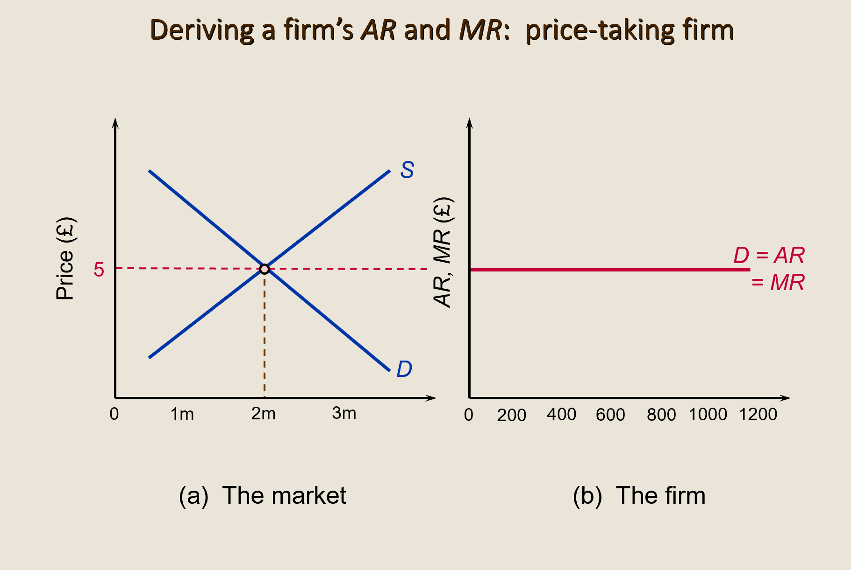
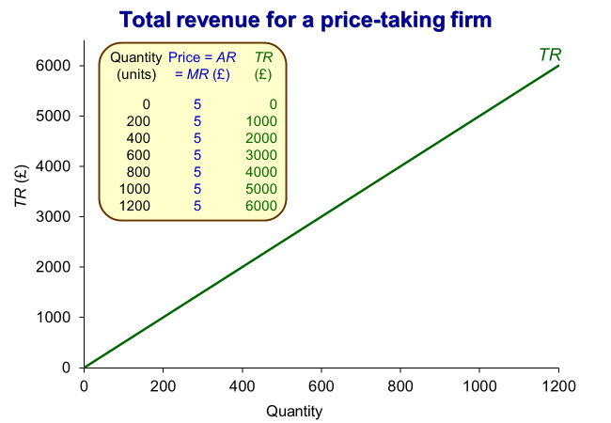
Revenue – Price Takers
Notes:
13

Slide 8
2. Revenue curves when firms are price makers
  Rather than accepting (or taking) the market price, firms would generally prefer to be a price maker.
  This means that if a firm wants to sell more, it must lower its price (due to the law of demand).
  Alternatively, it could raise its price, if it was willing to accept a fall in demand.
  As such, a firm that is a price maker will face a downward sloping demand curve.
  Firms will tend to benefit from being price makers.
  The TR, AR and MR curves will look quite different when price does vary with the firm’s output.
Notes:
14

Slide 9
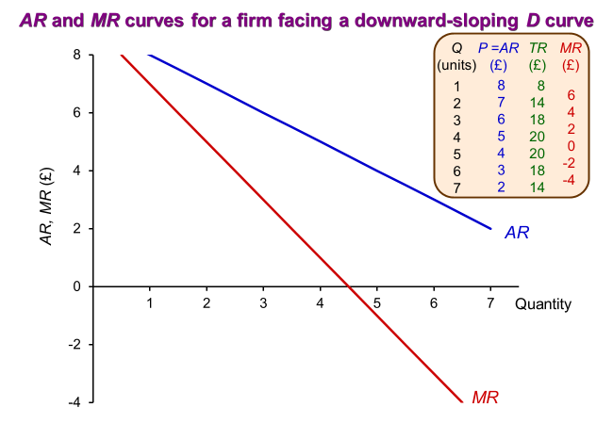
Revenue
(Price Makers)
  Average revenue (AR)
  If the price must be reduced to sell more output, AR will fall as output increases.
  The demand curve and the AR curve lie along the same line
  Marginal revenue (MR)
  When a firm faces a downward-sloping demand curve, MR will be less than AR
  If a firm is to sell more per period, it must lower its price (assuming it does not advertise)
  This will mean that lowering the price not just for the extra units it hopes to sell, but also for those units it would have sold had it not lowered the price.
  Thus, the MR is the price at which it sells that last unit, minus the loss in revenue it has incurred by reducing the price on those units it could have otherwise sold at the higher price.

Slide 10
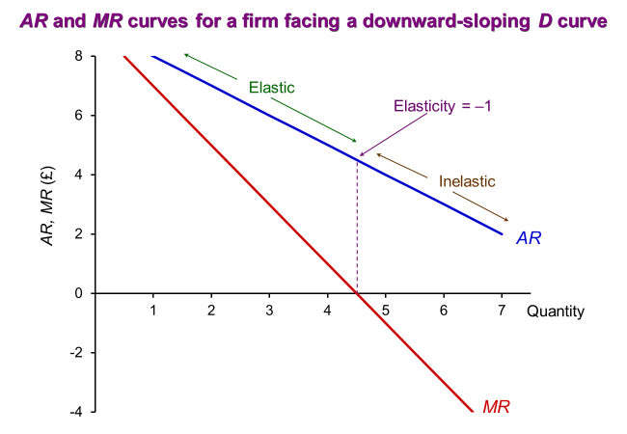
Revenue – Price Makers
  If demand is price elastic, a decrease in price will lead to a proportionately larger increase in the quantity demanded and hence an increase in total revenue.
  Marginal revenue will therefore be positive if the good has elastic demand and the price is reduced.
  If demand is inelastic, a decrease in price will lead to a proportionately smaller increase in demand and total revenue will fall.
  Marginal revenue will therefore be negative if the good has inelastic demand and the price is reduced.
  Although we have straight-line demand curve (AR), the price elasticity of demand is not constant along it.

Slide 11
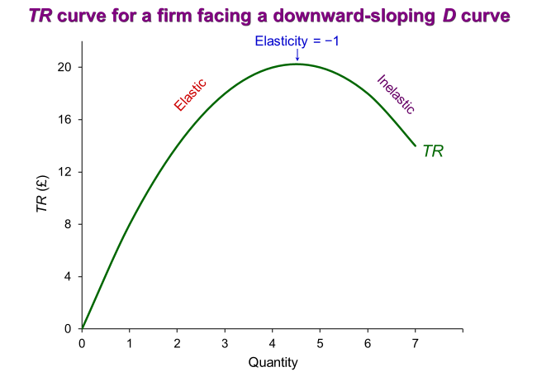
Revenue – Price Makers
  Total revenue (TR)
    It is a curve that rises at first and then falls
    If MR is positive (and hence demand is price elastic), a rise in output will raise TR
    However, once MR becomes negative (and hence demand is inelastic), TR will fall
    The peak of the TR curve will be where MR = 0
    At this point, the price elasticity of demand will be equal to -1.
    *A change in any determinant of demand other than price, such as tastes or income, will shift the demand curve. By affecting the price at which each level of output can be sold, it will cause a shift in all three revenue curves.

Slide 12
Profit Maximisation
We can now put costs and revenues together to find the output at which profit is maximised, and how much that profit will be.
There are two ways of determining the level of output at which a firm will maximise profits.
  Using total cost and total revenue curves
  Using marginal and average cost curves and marginal and average revenue curves.
In both cases, we concentrate on the short run.
In both cases, we take the case of a firm facing a downward-sloping demand curve, i.e., a price maker.
Notes:
15

Slide 13
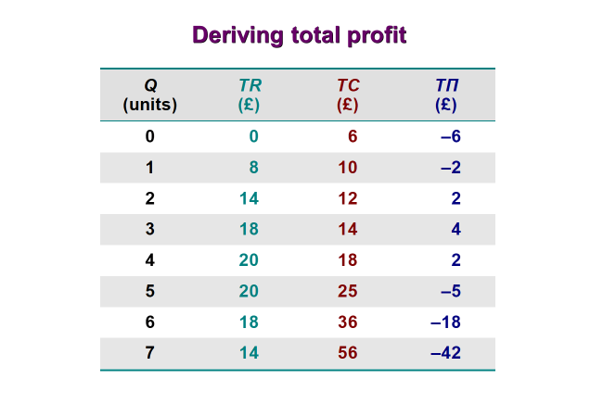
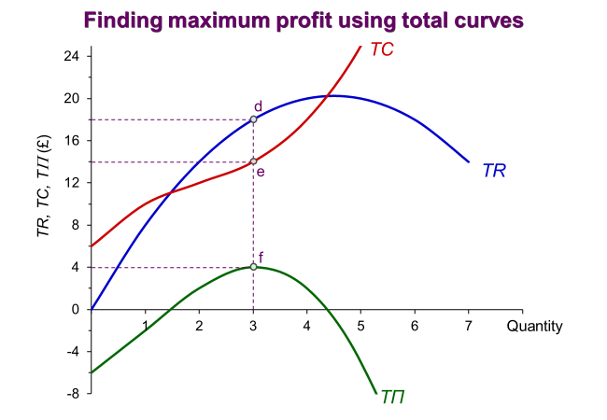
Profit Maximisation
Activity:
What is the profit-maximising level of output in this example?
What is the level of profit at this level of output?
Method 1: Using total cost and total revenue curves - total profit is found by subtracting TC from TR. Where total profit is negative, the firm is making a loss. Firms aim to maximise the difference between TR and TC.

Slide 14
Profit Maximisation
Method 2: Using marginal and average curves
The first stage is to find the profit-maximising output, the second stage is to find out how much profit is made at this output.
  Stage 1:
    There is a very simple profit-maximising rule: profit is maximised where MR = MC
    If MR > MC, producing more units will lead to a bigger addition to revenue (MR) than to cost (MC) and total profit will increase.
    If MC > MR, profit can be increased by cutting back on production.
  Stage 2:
    We use AR and AC curves to measure the size of the profit (and the product’s price)
    First, average profit is found (this is simply AR – AC).
    Then total profit is obtained by multiplying average profit by output (T𝜫 = A𝜫 x Q)
Notes:
15

Slide 15
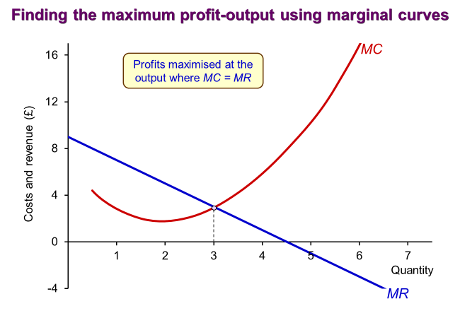
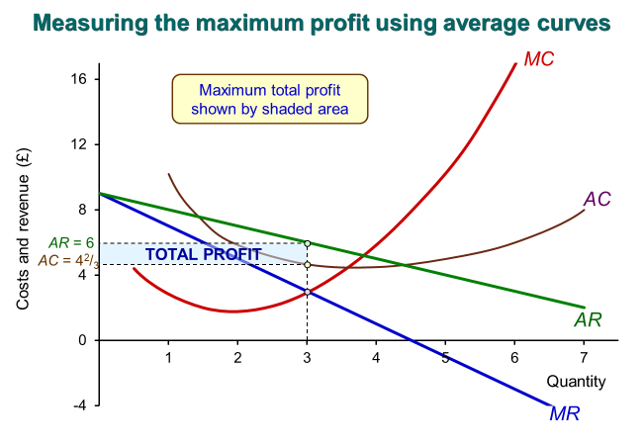
Profit Maximisation

Slide 16
Profit Maximisation
How can a firm increase profit?
Activity – based on what you have learned, discuss with a partner(s) what you might do to try and increase the profit of a firm?
Notes:
15

Slide 17
Profit Maximisation
The meaning of ‘profit’ in economics
One element of cost is the opportunity cost to the owners of the firm incurred by being in business – the minimum return that the owners must make on their capital to prevent them from deciding to close down
This opportunity cost to owners is sometimes known as normal profit, and is included in the cost curve
The normal rate of profit is determined by:
    The opportunity cost of capital (i.e., the interest that could have been earned by lending it in some riskless form, for e.g., putting it in a savings account in a bank)
    A return to compensate for risk – if they earn more than normal profit, they will prefer to stay in this business. If they earn less than normal profit, they will consider using the capital for another purpose.
Given that normal profits are included in costs, the profit shown in the earlier diagram was profit over and above normal profit – this is often known supernormal profit, pure profit, economic profit or sometimes just profit.
Notes:
16

Slide 18
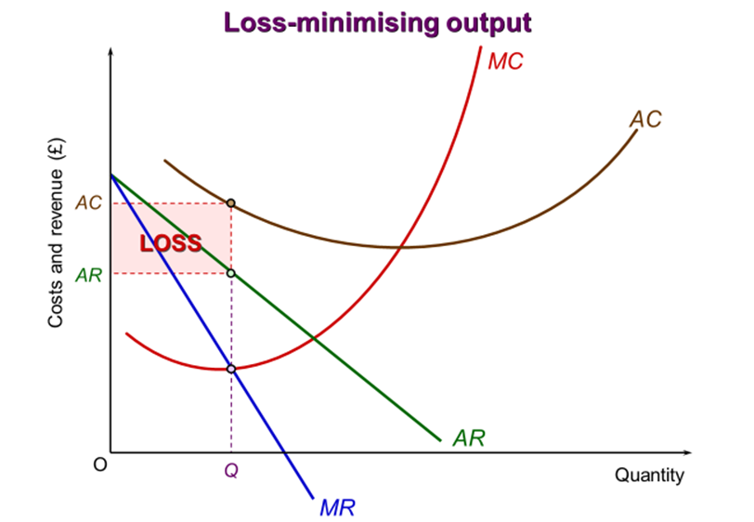
Profit Maximisation
What if a loss is made?
It may be that there is no output at which the firm can make a profit
The AC curve is above the AR curve at all levels of output
In this case, the output where MR = MC will be the loss minimising output
The shaded area in the diagram shows the amount of loss
Notes:
16

Slide 19
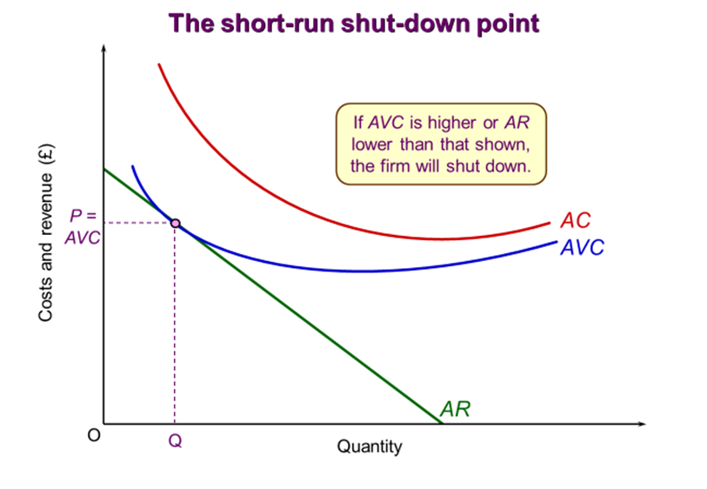
Profit Maximisation – Whether to Produce at All
  Short-run shut-down point: P (AR) = AVC
  Fixed costs must be paid, even if the firm is producing nothing.
  Providing the firm is more than covering its variable costs, it can go some way to paying off these fixed costs and will therefore continue to produce.
  A firm will shut down if it cannot cover its variable costs.
  Long-run shut-down point: P (AR) = LRAC
  All costs are variable in the long run.
  If a firm cannot cover its long-run average costs (which include normal profit), it will close.
Notes:
16

Slide 20
Summary
The revenue curves of price takers look quite different to the revenue curves of price makers.
Profits are maximised where the difference between TR and TC is maximised or where MR = MC.
It may be that there is no output at which the firm can make a profit, in this case, the output where MR = MC will be the loss minimising output
In the short run, a firm will shut down if it cannot cover its variable costs. In the long run, a firm will close if it cannot cover its long-run average costs.

